Slide 1


ALL MAPPED OUT
An introduction to process mapping and value stream mapping
Gwen Nicholson, Head of People Development and Corporate Governance
DG Health & Social Care Support Division
Notes:
Thanks for inviting me.
Gwen Nicholson, Head of People Development and Corporate Governance in the Health & Social Care Directorates. I have a background in continuous improvement and have been delivering continuous improvement sessions on and off for around 14 years.
The purpose for today’s session is to provide you with some information on process mapping and value stream mapping – with the hope that this will help you as you move your work from SAS to R.
Hopefully by the end of the session you’ll have a basic understanding of using ‘process mapping’ as an improvement tool and I’ve helped you to understand and recognise the ‘value stream’; how to identify value and the concept of value stream mapping.

Slide 2
Content
What is a process and what is process mapping?
Why use process mapping for improvement?
What should you map?
Compiling and analysing a process map
Understanding Value
Identifying Value Add and Necessary Non-Value Add and Waste
Creating and analysing the value stream map
Summary
Notes:
Here’s what we are going to cover today.

Slide 3



Hopefully something for everyone…..
Notes:
I’m conscious that you might all be starting from a different place, with different levels of experience, skills and expertise – some of you might have never worked on process maps before, some of you might just need a bit of a refresher and a reminder of where to go and how to go about it – some of you might be absolutely fine with this – so if you’ve had experience of these things before, please feel free to pop some comments into the chat bar as we go – similarly, if any of you have any questions, just stick them in the chat bar and I’ll try and pick them up as we go – there will be time at the end for a bit of chat too so we can pick stuff up at that point.

Slide 4
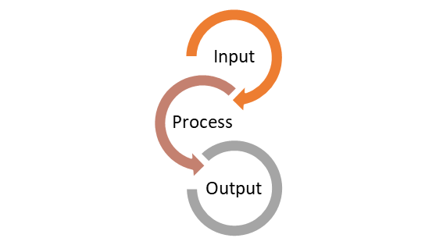
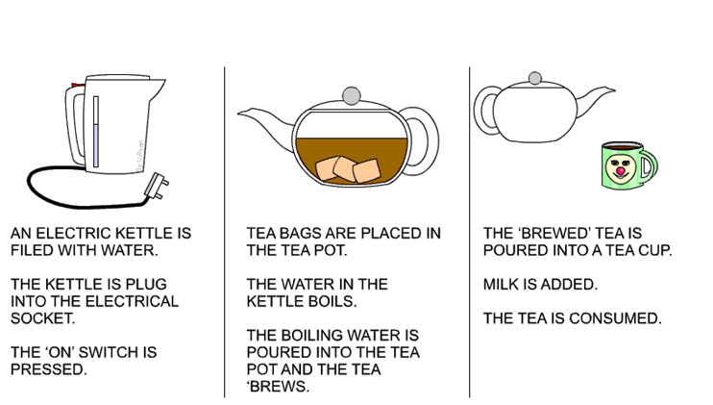
What is a process?
Notes:
So what is a process? It’s a series of steps and actions that produce a product or a service. It can be made up of a blend of people, equipment, method, materials and environment.
This description fits everything we do, from getting up in the morning to starting work – even making a cup of tea is following a process. We follow processes for supporting a debate in Parliament, responding to correspondence etc – all are processes.

Slide 5
What is process mapping?
Person
Action
Thing
Person
Action
Thing
Person
Action
Thing
What actually happens
End to End Process – Big Picture
Notes:
Process mapping is a tool which can help us see the “bigger picture” in any process.
It is a method used to identify who does what over time across the end to end process.
The map shows how things are and what actually happens, rather than what should happen.

Slide 6
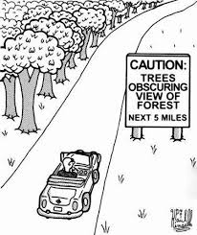
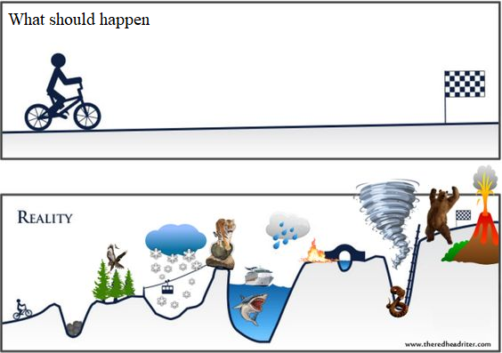
WhY USE PROCESS MAPPING FOR IMPROVEMENT?
Notes:
One of our traits as humans is to immediately jump to solution mode rather than properly understand what is actually happening in a process – even something simple, once it’s mapped out can throw up unexpected areas or steps which jumping to that solution too quickly might have missed – and could genuinely be something that might be done differently, saving you loads of time or adding to the quality of the service or product. So process mapping helps us to see the wood from the trees. It also helps us to map out what is actually happening in a process as opposed to what should happen.
We probably all have standard operation procedures or guidance for things – but how often does what is supposed to happen, actually happen? And of course, it’s never going to be 100%, one hundred per cent of the time, but the idea with both process mapping and value stream mapping is that you aim to reduce as much variation in what happens as you can.
Using process mapping as a diagnostic tool, helps those involved in the process to look at the bigger picture and helps them to really understand their role and the impact their actions have on the whole process, and can help to illuminate why your customers or stakeholders might feel a particular process is complex and confusing.
Data collection and process mapping is something that people either love or hate – some find it really onerous, but I promise you, the more work you put into truly understanding your processes, the more likely you are to come up with something which will save you time and deliver better value/better quality work.

Slide 7
WHAT SHOULD YOU MAP?
High level process map
6–12 steps
Complete in set time e.g. 20 minutes
Use to identify scope and identify problem
No rework loops and minimum complexity
Low Level or Detailed process map
Dozens of steps
To establish loops and complexity
Good to establish roles and relationships within process
Use again in later phase to show effect of redesign
Notes:
You could start with a high level process map – start to finish should be between 6 and 12 steps – give yourself, say, 20 minutes to complete this – person, action, thing. Very quick and dirty.
You can then use this to agree your scope – where are your start and end points (e.g. cup of tea – start point, the request for the cup of tea, or filling the kettle, or moving into the kitchen; PQs – are you including the bit that happens in parliament before it comes to you, where is your end point – pressing the button to send it to the minister, or once it’s answered in parliament)
A high level process map doesn’t need to include any loops back where work has had to be redone and shouldn’t have too much complexity to it.
Once you have your high level – start to tease out the steps a bit more, include any handovers or where things loop back (e.g. you’re asked to draft something then it goes back to the person who asked you, then it comes back to you again for sending on….) – can do them as swimlanes, any rework, add timings - using swimlanes means you can look at the roles people have within the process, what the impact of a delay in one step has on the next part of the process.
Once you’ve implemented a change you can follow the work again to see if the changes made have made a difference – again, a way to see that a change in one part of the process might have impacted – either positively or negatively – on another part.

Slide 8
Compiling a process map
Scope – where does the process start and end?
Who should be involved in the mapping process?
What level of detail will we map?
Name of the person completing the task; verb/task; time taken to complete activity
Map what actually happens
Assemble the post-its to create the journey (remembering that some activities happen in parallel)
Notes:
There are a few things you should consider before and during the creation of your process map:
Scope – are you clear on the start and end points? These need to be fixed early, so that you avoid scope creep.
Do you have people who are involved in all parts of the process – this doesn’t necessarily mean everyone needs to be in a room or all online at the same time – but consider how you involve everyone (get a room, have an online document which everyone can access) – you can’t beat post its and a massive roll of paper for this, but there are tools (such as Mural or the Teams whiteboard) that you can use if you want to do something online only – you can still create post-its with online tools.
Decide early on what level you are going to on the first pass – do you want to do high level first or dive straight into individual steps in a low level map. Depends how complex your process is.
During the development – make sure you are mapping what actually happens – the guidance might say that something should go to a director for clearance – does it? Or does it go elsewhere?
Move the post its around to create the journey – and if some activities happen in parallel have the below each other on your map, so you can see that.

Slide 9
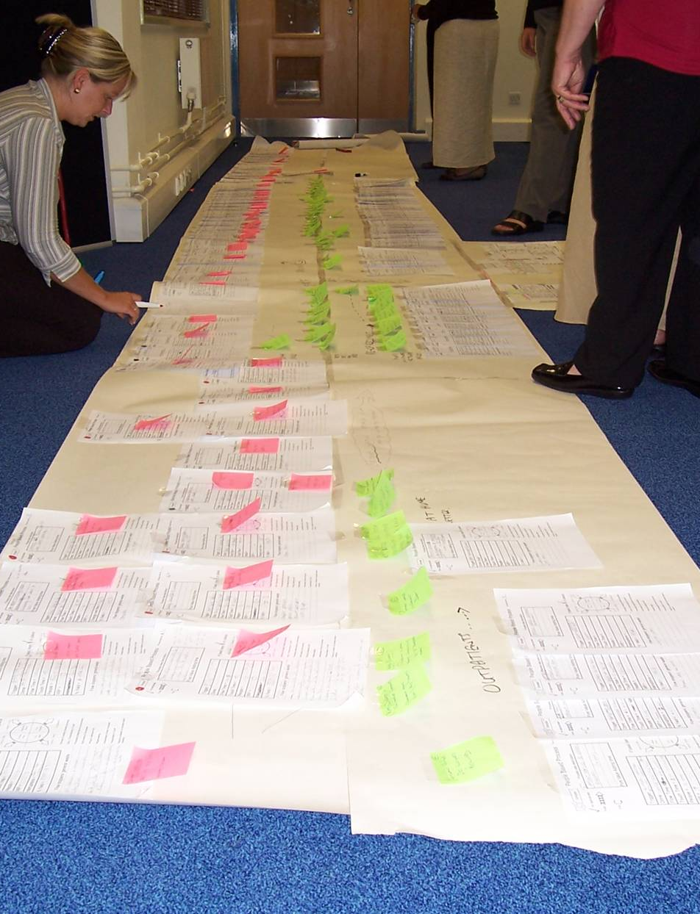
Analysing a process map
How many steps in your process?
How many duplications?
How many hand-offs?
What is the approximate time taken to complete each step and time taken between each step?
Where are possible delays?
Where are major bottlenecks?
Notes:
Here’s a process map that was developed – hopefully that gives you a good visual of what it might look like – the pink posts are the steps (with some papers behind them to back up the activities) then the green ones are the timings.
Using swimlanes is a good way to visualise the number of hand offs (for example, does one person see the same piece of work three times?) you’ll also see the delays and possibly bottlenecks.
So that helps you analyse what your process does look like, but how do we build on that to check on the value add?

Slide 10
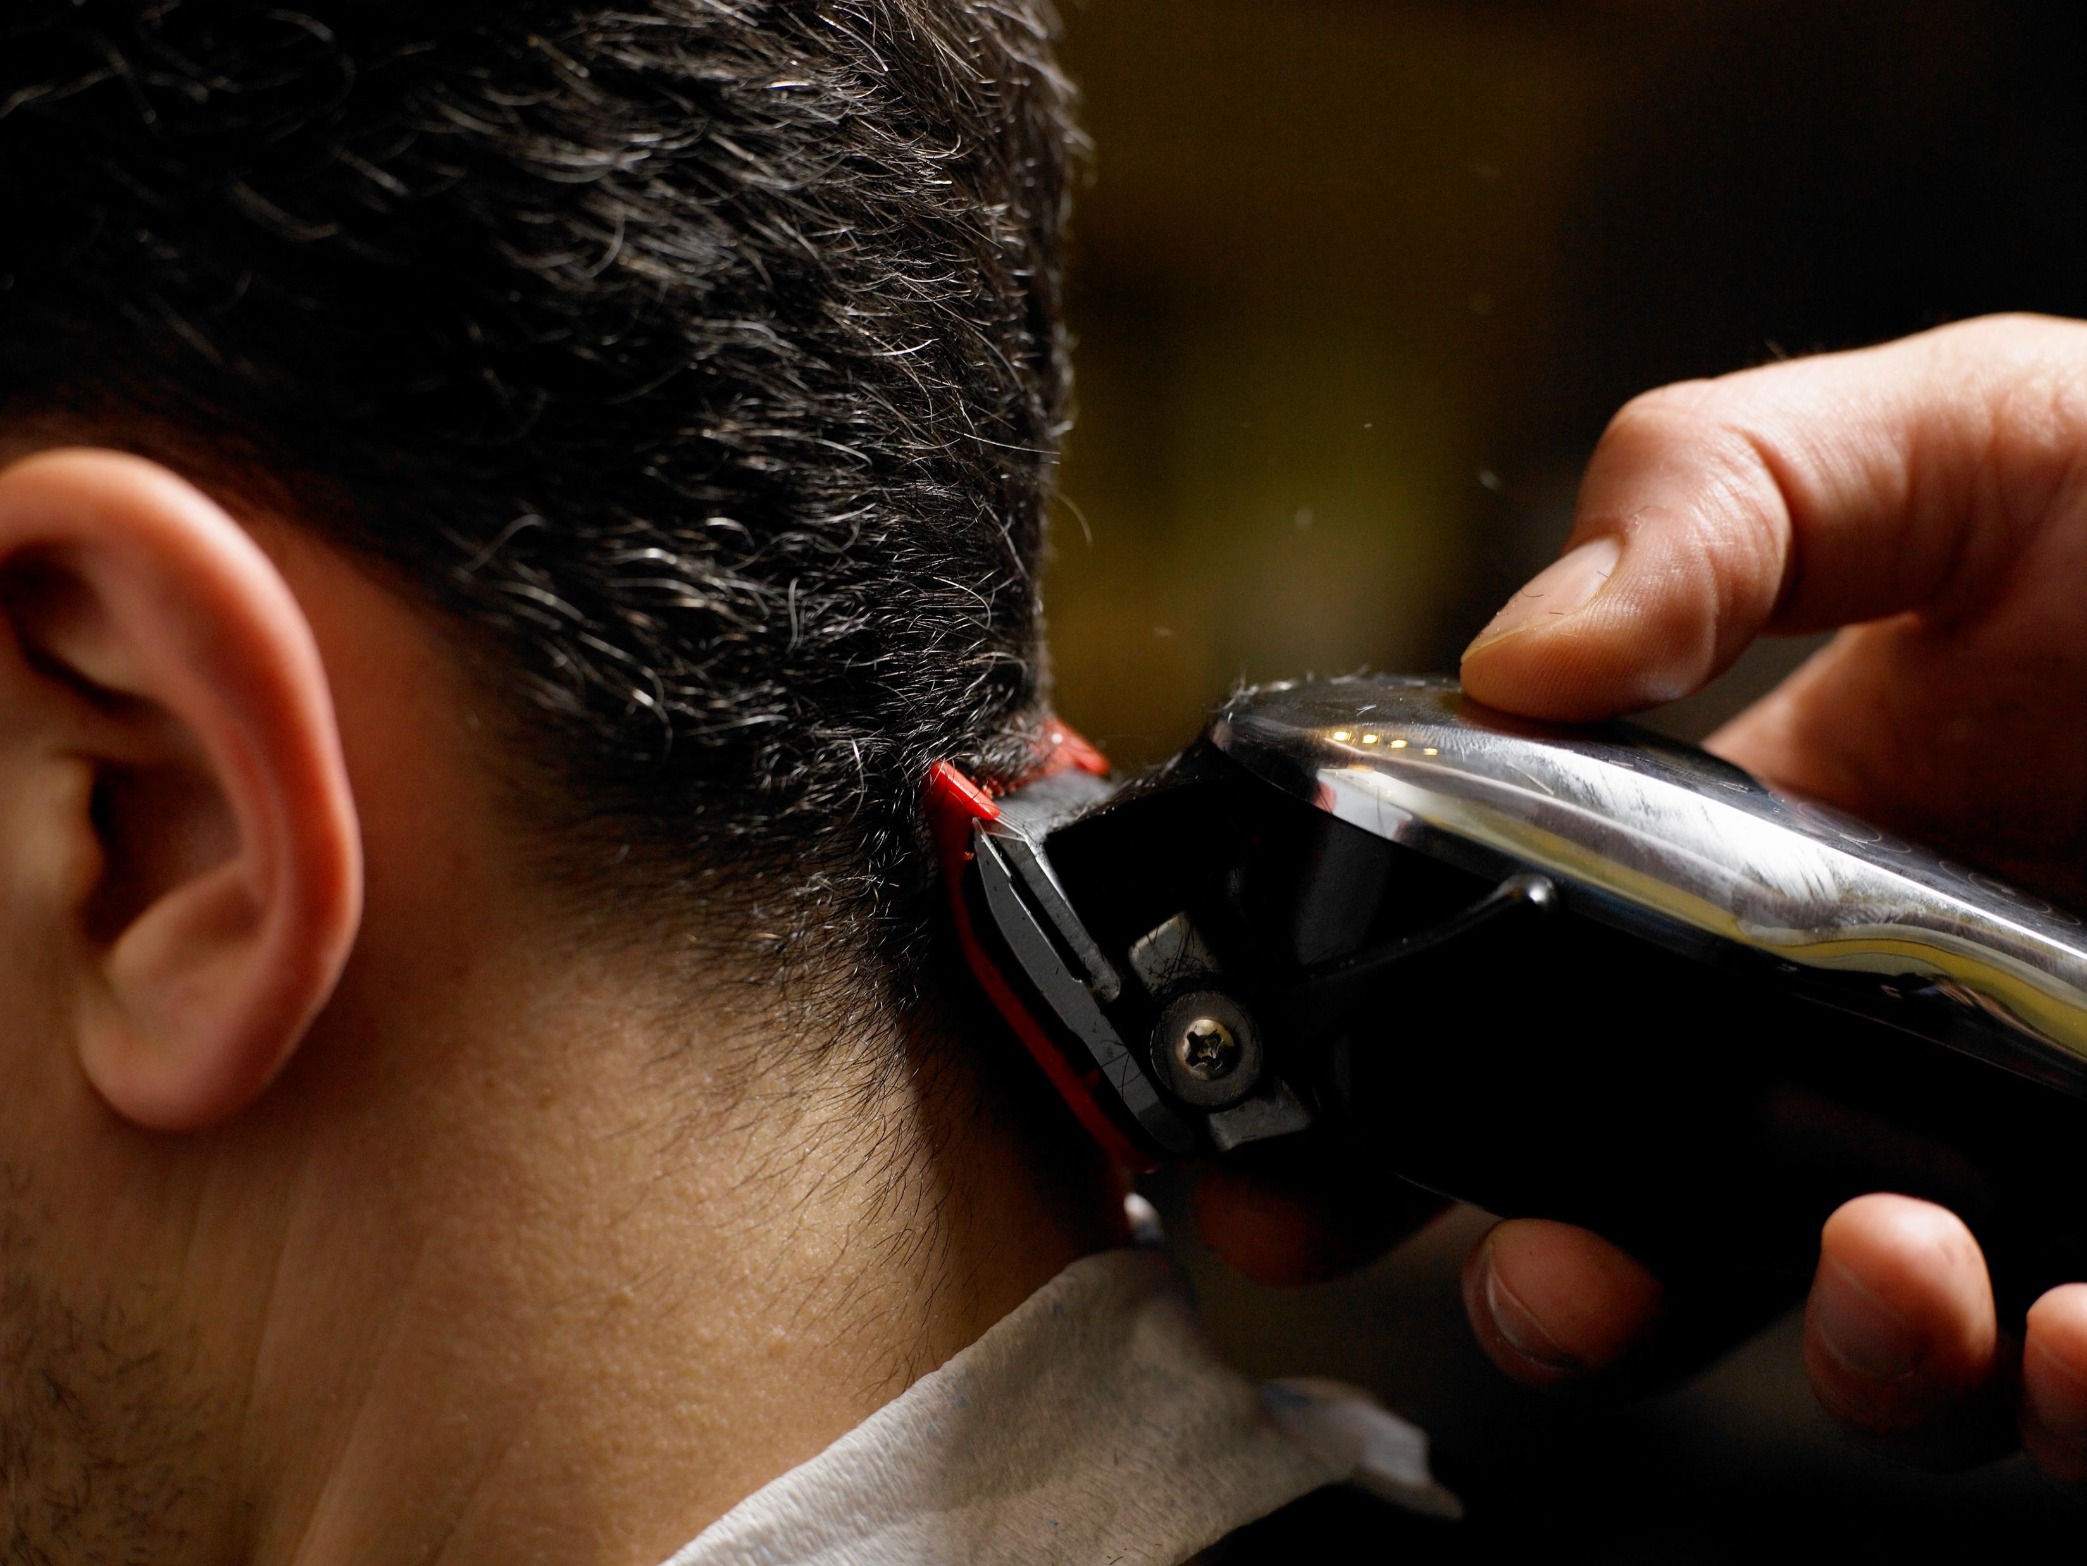

What is value?
Notes:
First thing is to ask what do we mean by value.
Haircut exercise - Value can be anything that the ‘customer’ perceives to be important to them. For example, what would you expect to pay for a haircut? It’s essentially the same service, but what people value in that service differs.
In Government we can have many different customers – do you know who your customers are? Ministers, correspondents, other colleagues?
It’s important that you know what your customer values – so if you can ask them, ask (we have our ministerial preferences for example; do other colleagues need us to provide them with the information set out in a particular way?)
Value stream mapping builds on process mapping as it helps you understand where within your processes you are adding value to your customers and a value stream is all of the activities in a process that you undertake to deliver a product/service which are of value to your customer. And, you may be surprised to hear that it’s not as many activities as you might think.

Slide 11
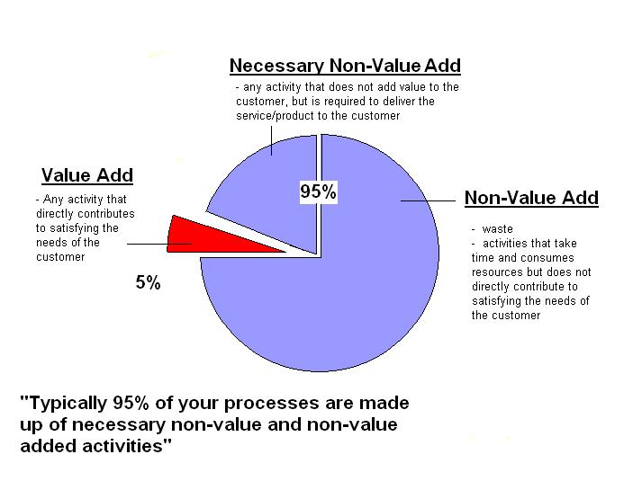
Value Adding Activities AND CHALLENGING NON-VALUE ADD
Challenge this bit
Identify, reduce/eliminate this bit
Notes:
Any process that we work with is made up of three sets of activities:
Value Added: the things that directly contribute to satisfying the needs of the customer. For example, Cab Sec asks for a submission on options for the number and location of ambulance service control rooms. They aren’t interested in all the work that goes into that – who you speak to, what data you pull in, what you analyse etc – he just wants the paper, with good advice on a number of options and a recommendation. So essentially the only part of the process which directly adds value to the customer is that final submission going forward.
The next set is necessary non-value added steps – the things that have to happen in order for you to get to the end result. In the Cab Sec submission case, this will be about collecting and analysing the data, speaking to people about pros and cons (maybe a consultation?). On a practical note – if you’re making a cup of tea, then you have to boil the kettle. These activities tend to build up over time – become a bit of a “well we’ve always done it that way” approach – but that doesn’t mean we can’t question them and see if we are doing them in the most effective way. For example, is there a way for us to lay our hands on that data more quickly (could technology help us there); for the kettle, if it’s taking 10 minutes to boil, are we filling it too full for just one cuppa, or do we need to invest in a new kettle.
The final set of activities is the non-value added bit – the things that take up time and resource but don’t directly contribute to satisfying the needs of the customer. In the Cab Sec submission case it could be incorrect data, waiting too long for a contribution; with the cup of tea scenario it could be not having tea bags, so needing to nip to the shops; some of the things that used to be necessary non value add, could feasibly become non-value add over time (e.g. manually collecting data, more chance for human error, becomes a defect; change of position of a plug, means you can start to decrease your movement around your kitchen if you move your kettle from where it could only be before)
So it’s about challenging the necessary non value add stuff, and then identifying, reducing or eliminating the non-value add – any process can be improved by reducing the waste within it.

Slide 12
Eliminating Waste
Transportation | Moving “stuff”
Inventory | “Stuff” waiting to be done – stock or work in progress
Motion | Unnecessary human movement
Waiting | Whenever something is not moving or being processed or people waiting for “stuff” to arrive
Over processing | Stuff we have to do but doesn’t add value e.g. writing reports that are never used
Overproduction | Producing too much “stuff”
Defects (rework) | Anything that is not done right the first time
Staff | Untapped potential
Notes:
A reminder of what TIMWOODS stands for.
T - When you transport stock, paperwork and equipment unnecessarily, you do not add value. Can also be about handling paperwork – how many handoffs does a submission have for example? What about authorising environment - how many steps in the process?
I – a build up of things to be done – this could be a build up of stationery that’s not being used (would be stock in a factory environment) – when things are building up and nothing is happening with them – too many emails to process/a build up of meetings to attend.
M – Motion is related to movement of people. Whether that’s round an office to find things, or speak to colleagues, or moving to and from offices. Not such a thing now we are working from home I suppose.
W - Waiting is where you are not being productive because you are waiting for another person or for a process to be completed before you can complete your work e.g. when you wait for authorisation, documents to be worked on/for comments, responses or contributions to something, waiting on equipment
O – overprocessing is where you may be working very hard, but not necessarily in the most effective way. You are creating waste which is not always easy to see and can often be mistaken as part of the process. For example: when you produce documents/charts/notes which are never seen or are hardly ever used; when you finish documents above the required standard (sending things back to be corrected because of style rather than quality/content – red pen syndrome)
O - Over-production is where you produce an excess of activity within processes, or services, without any real requirement for them ‘just in case’ you need them.
e.g. copying people into emails when they do not need to know the information; Write overlong emails; Attend meetings because they have aye been in the diary; Print more handouts than are required for a meeting
D – or rework - This is where you undertake a task but do not complete it correctly first time. You may find the task needs to be redone, or adjusted before it is completed. This is one of the most common forms of waste and is apparent in nearly all of the processes that you do. E.g. when documents need corrected due to incorrect information or typos; double book appointments; cancel and reschedule meetings; re-saving documents because you can’t find the original.
S - Staff are the most valuable asset in any organisation. Without them our organisation can not function. This waste occurs when staff are not used to their full potential, are not empowered, are not listened to e.g. when you do not listen, ask, or empower staff or when you do not do anything with the ideas that they suggest. Staff work with our processes all the time – they will often know what the hassles, headaches and bugbears are and 9 times out of 10 they are also likely to have a fair idea about how to fix them – they just need that authority (and safe space) to try out changes, without a fear of being blamed if something doesn’t quite work out the way we expected.
Just a couple of things to remember when looking at identifying waste within a process – it’s critical to recognise that the non value adding activities and indeed the necessary non-value add activities may have been a core part of someone’s job for many years – it’s therefore important when looking at process and value streams to be clear that it’s the activities that are non value adding not the person.

Slide 13
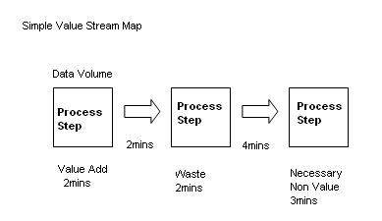
creating and analysing a value stream map
Who is your customer?
Notes:
Going back to our map from earlier – first thing to agree on is who is your customer? Then along the bottom of the map you could add a key for the things that are value add, necessary non value add or waste – and you could put question marks next to the bits that you maybe need to check or have someone else clarify what’s going on there.

Slide 14
creating and analysing a value stream map
How many steps add value? (% of value adding steps)
Time spent adding value?
How many times does the process run ‘right first time’?
Identify the wastes within the process, consider how to reduce
Notes:
Questions to ask once you have added your value stream – how many of the steps add value as a percentage of the number of total steps in the process (remember actually happening not what should happen)
Total amount of time of process versus time adding value
How many times does the process run “right first time” – so this is where you do some checking on your process map to make sure the steps actually happen – or was it just a once off on the time you are thinking about – which is why it’s good to involve everyone in the process.
Identifying the wastes but more how do you think you will reduce them? Duplication? Reduce hand offs? What’s going to work for the whole process – changing one step, how does that impact further down the line?

Slide 15

Observe and Gather Data
Walk the journey – “see” the actual workplace
Follow and make notes about each component
What happens to the ‘thing’
What colleagues are doing
What the information / communication flow is
Take photos of wastes
Notes:
All those questions are why it’s important to go and see - walk the journey
Take notes as you go – make sure colleagues know what you are doing, it’s about systems and processes, not people.
Photos are powerful story tellers.

Slide 16
Push Process
Duplication
Bottlenecks
Queues
Waiting
Pushing through process
Notes:
The next two slides are quite a good way to visualise how a process might flow smoothly – I use the paper clip analogy a lot. A lot of services are delivered where work/activities are pushed through – this results in queues, bottle necks, waiting, duplication
At different stages of a process – imagine planning applications – one part of the process might be to log the form – quick and simple and takes no time, it is then passed onto the planner to consider, they take longer to do this part of the process and if the volume of applications increases, it is easy to see why bottlenecks would occur – and in turn this means that people wait longer. The person has no control over when they can receive the next piece of work.

Slide 17
Pull Process
Pulling through process
Reduce queues
Work done in order
No duplication
Improved quality and experience
Notes:
If you can think about how you might pull things through the process rather than have them pushed into the system that will help you to have a smoother flowing process - pulled through as and when required. So in the example with the planning applications, the planner would tell the person before when they were ready to take the next case.

Slide 18
Answering MCS
1 day
10 working days
MCS case entered into MACCS
AO sends draft to line manager for approval
MCU allocate to Action Officer
Action Officer accepts/rejects PQ
AO requests contributions (if required)
AO receives contribution
Write draft response & check template
AO receives approval to submit final reply
Increasing level of detail
Low Level Map
MSP receives written response
AO Submits to Private Office
Private Office sends final response
MCU receives correspondence
1 day
Notes:
Here’s an example of how a high level process map might start off – then you could add in your increasing level of detail on a low level map – more bits in the part where it’s talking about contributions (how long does it take for the action officer to find the person they want to request a contribution from – what do they do with it – swim lanes would be good here – and how much of this adds value to the customer at the end of the day – who is the person who wrote the letter (or is it??)

Slide 19
summary
Be clear about your scope – the start and end
Is everyone who is involved in the process involved in the process mapping
Be inclusive – not necessarily about everyone being there at the same time
Be clear about your level of detail
When identifying waste, it’s about the activities, not the person
Celebrate your successes
Notes:
So just to summarise – before you start process mapping, be clear on your scope, what are your start and end points and stick to those to avoid scope creep
How are you getting everyone involved in the mapping – this will help people to feel empowered and comfortable to make suggestions about what might make process work more effectively – and sustainable, if the people involved in the process are involved in the improvement work then any changes made are more likely to stick.
Think about where and how you are going to do your process mapping – everyone in a room all at the same time? Use a room where people can add things when they are in? Online?
Remember when questioning steps in the process this is about the activities in the process not the people involved
If you achieve an improvement, celebrate your success! Share your good practice with others.

Slide 20

What’s Next?
Over to You!
Questions?
Thank You!
Notes:
Opening the floor up to you now – what’s chimed for you?
Any questions, comments, observations?
Thanks again for inviting me and good luck with your project.

